Slide 1
Indexing similarity for efficient search in multimedia databases
Tomáš Skopal
Dept. of Software Engineering, MFF UK SIRET research group, http://siret.ms.mff.cuni.cz

Slide 2
Similarity search
subject: content-based retrieval
„signal“ data like multimedia, time series, geometries, structures, strings, sets, etc.
not structured to meaningful attributes, i.e., RDBMS not applicable
the query-by-example concept is the only possibility
no annotation available (keywords, text, metadata), just raw content
model: similarity space
descriptor universe U and a given similarity function δ
δ: U x U → R
similarity = multi-valued relevance
simple mechanism for content-based search
similarity queries – range or kNN queries, joins, etc.
database task: efficient similarity search

Slide 3
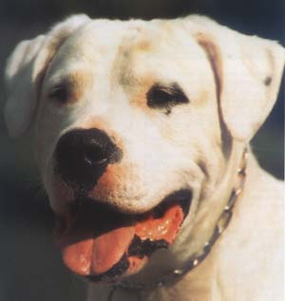
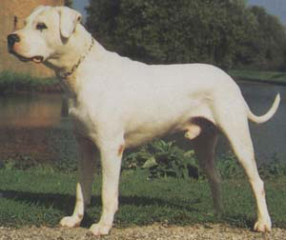
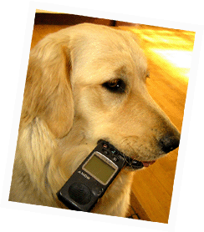
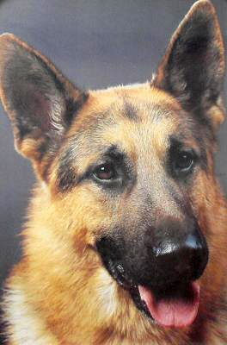
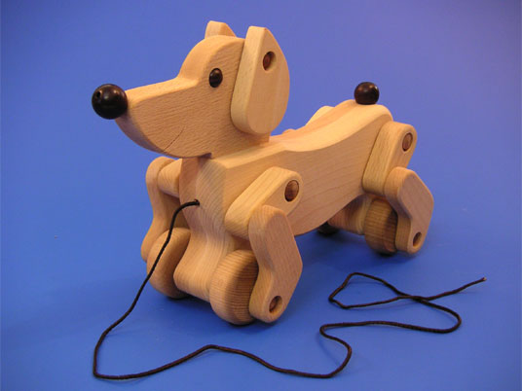
Basic similarity search concept: range and kNN queries
query object
ordering of database objects according to similarity to query object
Range query: select objects more similar to q than r
kNN query: select the k most similar objects to q
0.9
0.85
0.6
0.4
0.7

Slide 4
Example engine: MUFIN
developed at Masaryk university
http://mufin.fi.muni.cz/imgsearch/
distributed P2P similarity search engine
based on indexing under metric space model
indexing 100+ million images from Flickr (CoPhIR database)
five MPEG7 descriptors concatenated into 282-dimensional vectors (1 image = 1 vector)
Scalable Colour, Colour Structure, Colour Layout, Edge Histogram, Homogeneous Texture
global features
similarity: Euclidean distance
response within ½ second (on average)

Slide 5
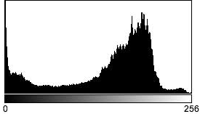
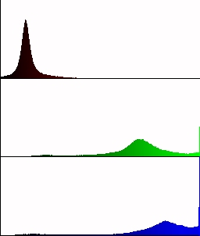
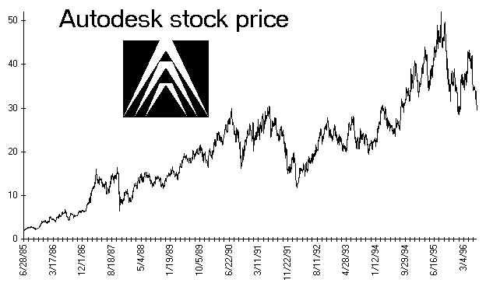
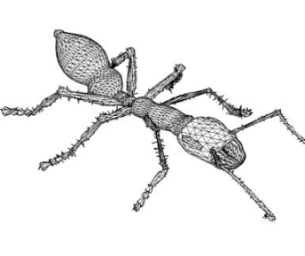
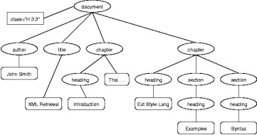
Features and similarities
how to model a similarity space?
vector spaces under
independent dimensions – (weighted) L_{p} metrics
correlated dimensions (e.g., histogram) – quadratic form distance, Earth mover’s distance
multiple subvectors in a single vector (combined)
times series – L₂ or DTW
sets
general sets (bag of objects, sets of sets), Hausdorff distance, Jaccard distance
geometries, bag of words, ...
strings
edit distance
graphs
trees, Tree edit distance
networks
etc.

Slide 6
Complexity of similarity measures
cheap O(n)
Lp distance, Hamming distance
more expensive O(n²)
quadratic form distance, edit distance, DTW, Hausdorff distance, Jaccard
even more expensive O(n^{k})
tree edit distance
very expensive O(2^{n})
(general) earth mover’s distance

Slide 7
Metric approach to similarity search
assumption: the similarity δ (actually distance) is computationally expensive – often O(m²), sometimes even O(2^{m}) w.r.t. the size (m) of a compared object
querying by a sequential scan over the database of n objects is thus expensive
the goal: minimizing the number of distance computations δ(∗,∗) for a query, also I/Os
the way: using metric distances
general, yet simple, model
metric postulates
allows to partition and prune the data space (triangle inequality)
the search is then performed just in several partitions → efficient search

Slide 8
Using lower-bound distances for filtering database objects
a cheap determination of tight lower-bound distance of δ(*,*) provides a mechanism how to quickly filter irrelevant objects from search
this filtering is used in various forms by metric access methods, where X stands for a database object and P for a pivot object
The task: check if X is inside query ball
we know δ(Q,P)
we know δ(P,X)
we do not know δ(Q,X)
we do not have to compute δ(Q,X), because its lower bound δ(Q,P)-δ (X,P) is larger than r, so X surely cannot be in the query ball, so X is ignored
X
query
ball
P
r
Q

Slide 9
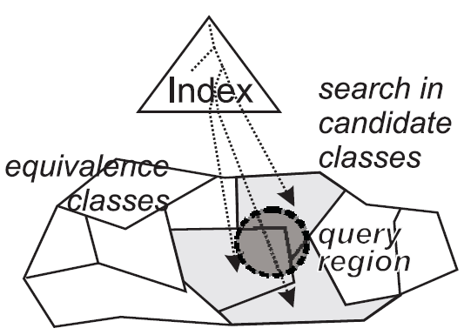
Metric access methods (MAMs)
indexes for efficient similarity search in metric spaces
just the distances are used for indexing (universe unknown)
database is partitioned into equivalence classes
index construction usually takes between O(kn) to O(n²).
all use the lower-bounding filtering when searching
pruning some, equivalence classes, the rest searched sequentially
various structural designs
flat pivot tables (e.g., LAESA)
trees
ball-partitioning (e.g., M-tree)
hyperplane-partitioning (e.g., GNAT)
hashed indexes (e.g., D-index)
index-free approach (D-file) [Skopal and Bustos, 2009]

Slide 10
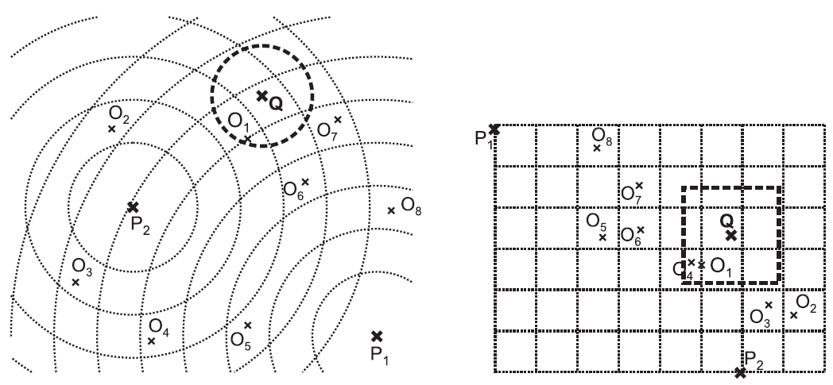
Pivot tables
 | P₁ | P₂
O₁ | 5 | 2.6
O₂ | 7.2 | 1.4
O₃ | 6.7 | 1.6
O₄ | 4.8 | 2.7
O₅ | 2.6 | 3.2
O₆ | 3.6 | 3.5
O₇ | 3.6 | 4.5
O₈ | 2.5 | 5.5
set of m pivots P_{i}
mapping individual objects into L_{max} space – distance matrix
v_{i} = [δ(O_{i}, P₁), δ(O_{i}, P₂), ..., δ(O_{i}, P_{m})]
contractive: L_{max}(v_{i}, v_{j}) ≤ δ(O_{i}, O_{j})
2 phases
sequential processing of the distance matrix, filtering
the non-filtered candidates must be refined in the original space

Slide 11
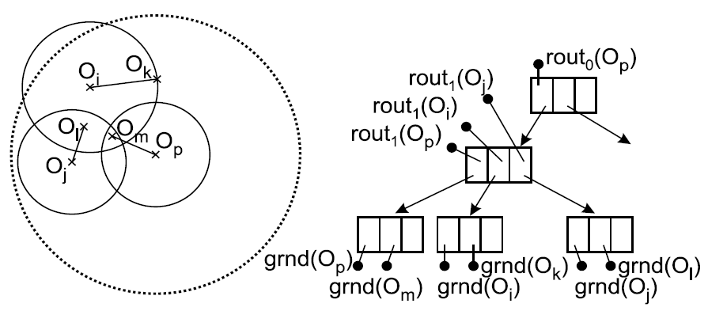
M-tree
inspired by R-tree – modification into metric spaces
hierarchy of nested balls; balanced, paged, dynamic index
compact hierarchy is necessary, ball overlaps lead to inefficient query processing
many descendants – e.g., M*-tree, PM-tree [Skopal, 2004, 2005, 2007]
range query
(Euclidean 2D space)

Slide 12
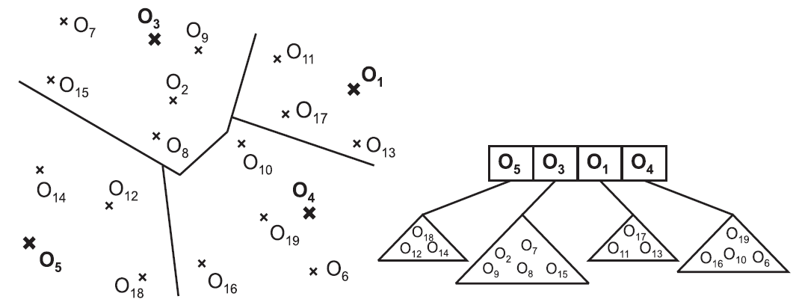
GNAT
unbalanced tree index (author Sergey Brin - Google)
“hyperplane”-based partitioning
no overlaps, but static index + expensive construction
Q

Slide 13
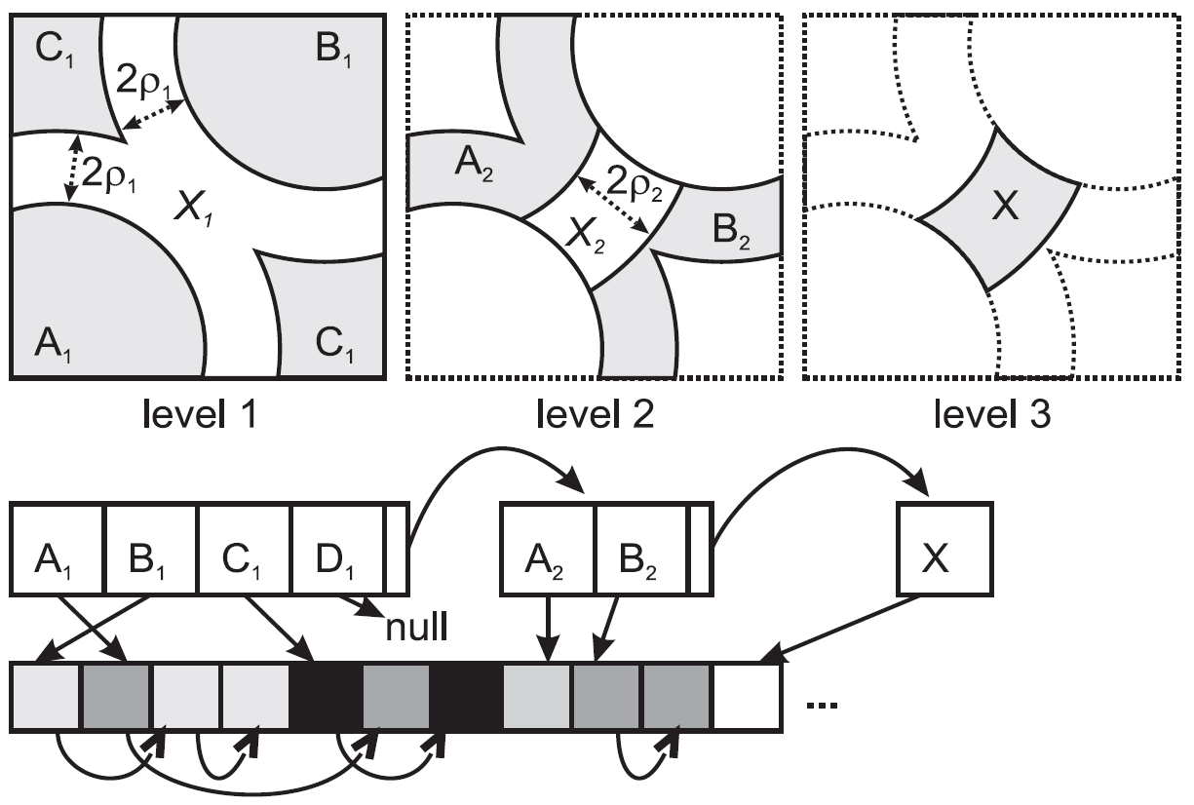
D-index
hashed index
based on partitioning hash functions bps^{1,ρ,j}, where P_{j} is pivot, d_{m} is median distance (to database objects) and ρ is split parameter
functions are combined, returning bit code of a bucket id
if the code contains a 2, the object belongs (is hashed) to exclusion bucket
the exclusion bucket is recursively repartitioned
multi-level hierarchy
good performance for small query balls

Slide 14
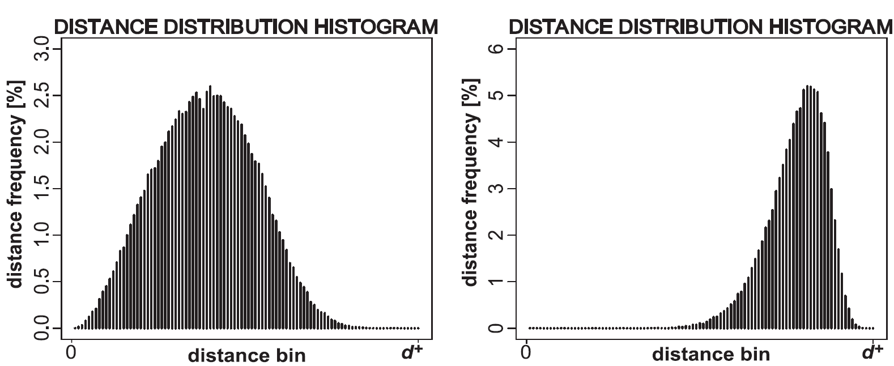
Indexability
metric postulates alone do not ensure efficient indexing/search
also data distribution in space is very important
intrinsic dimensionality ρ(S,d) = μ² / 2σ² (μ is mean and σ² is variance of distance distribution in S)
low ρ (e.g., below 10) means the dataset is well-structured – i.e. there exist tight clusters of objects
high ρ means the dataset is poorly structured – i.e. objects are almost equaly distant
kind of dimensionality curse
intrinsically high-dimensional datasets are hard to organize
querying becomes inefficient (sequential scan)
MAM-independent property
low intrinsic dimensionality
high intrinsic dimensionality

Slide 15
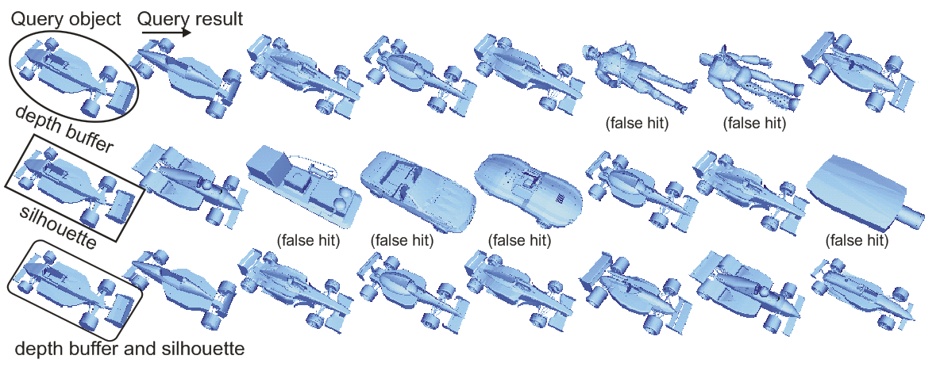
Advanced models of similarity search: parameterized similarity functions
linear combination of partial metrics = metric
similarity on multiple-feature objects
dynamic weighting
user-defined weights at query time – allows to select specific w_{i} (w.r.t. to query)
M³-tree [Bustos and Skopal, 2006]
index structure for multi-metrics, supports dynamic weighting

Slide 16
Advanced models of similarity search: novel query types
in very large databases, simple kNN query might loose its expressive power – many duplicates
distinct k nearest neighbors (DkNN) [Skopal et al., 2009]
selects k nearest, yet mutually distinct, neighbors
scalable expressive power (implemented to MUFIN)
10NN
D10NN

Slide 17
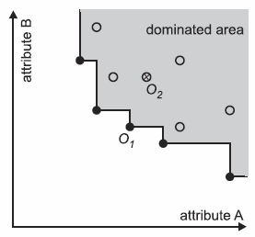
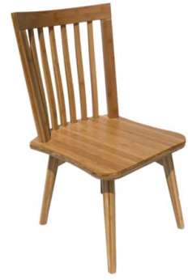
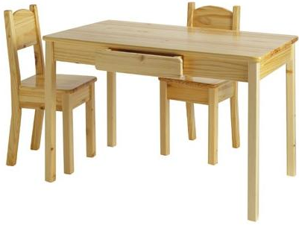
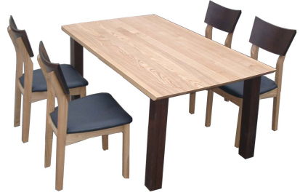
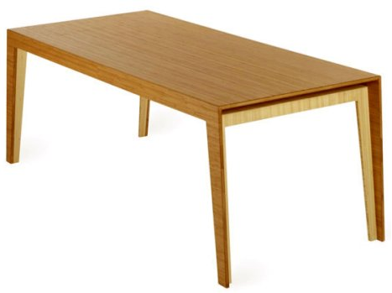
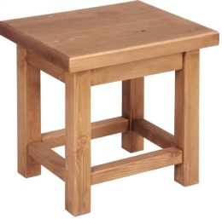
Advanced models of similarity search: novel query types
finding a single “holy-grail” query example could be very hard
multi-example queries can alleviate the problem
metric skylines
multi-examples query, k examples q₁, ..., q_{k}
database objects are mapped into k-dimensional space <δ(q₁, o_{i}), ..., δ(q_{k}, o_{i})>
then classic skyline operator is performed on the vectors
efficient PM-tree based solution [Skopal and Lokoč, 2010]

Slide 18
Beyond the metric space model
the requirement on metric distances is just database-specific
two parts of a similarity search algorithm
a domain expert provides the model (feature extraction + similarity function)
aims at effectiveness (quality of retrieval)
a database expert designs an access method for that model
aims at efficiency (performance of retrieval)
the domain expert is more important, the database solution is just an efficient implementation
naive sequential search might be sufficient
small database
cheap similarity computation
in such case an advanced database solution is not necessary

Slide 19
Non-metric similarity: Motivation
the domain experts (practitioners, often outside CS)
model their similarity ad-hoc, often heuristic algorithms
requirements on similarity to be metric is annoying
trading efficiency (indexability) for effectiveness (similarity model)
non-metric similarity – more comfort and modeling possibilities for domain experts
metric postulates questioned by various psychological theories
becomes hot topic nowadays with the increase of complex data types
[Skopal and Bustos, 2010]

Slide 20
Domain examples with nonmetric similarity search problems
bioinformatics (proteomics), chemoinformatics
local alignment of sequences (Smith-Waterman)
structural alignment of molecules (TM-score)
image retrieval
robust image matching (fractional Lp distances, many others)
audio retrieval
music, voice (nonmetric distance for time series)
biometric databases
handwritten recognition, talker identification, 2D & 3D face identification

Slide 21
Unified framework for efficient (non)metric similarity search
assume database solution is required (sequential scan too slow)
automatic transformation of a non-metric into metric
reflexivity, non-negativity is quite easy (declaratory adjustment)
symmetry can be obtained by max(δ(x,y), δ(y,x)) and the candidates then refined using asymetric δ
triangle inequality is the hard task (follows)
semi-metric distance = metric w/o triangle inequality
metric access method could be used for non-metric similarity search – for search in the transformed space, resp.
modification of δ by a function f, i.e., f(δ)
preserving the similarity orderings, i.e., giving the same query result
f is monotonously increasing, and f(0)=0
using f we can tune the “amount” of triangle inequality of f(δ)

Slide 22
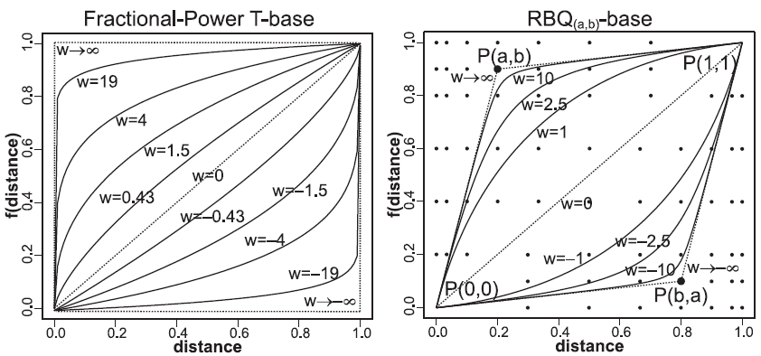
T-bases
T-base = a modifier f, additionally parameterized by w, the concavity (w>0) or convexity (w<0) weight
how to measure the amount of triangle inequality
triplets (δ(x,y), δ(y,z), δ(x,z)) on a sample of the database
T-error = proportion of non-triangle triplets in all triplets
T-error = 0 means full metric
the more concave modifier, the lower T-error, but higher intrinsic dimensionality
convex f does the opposite

Slide 23
TriGen algorithm
given a set of T-bases and given a T-error threshold,
the TriGen algorithm finds the optimal modifier (a T-base + w)
optimal = shows the smallest intrinsic dimensionality, i.e., highest indexability
then f(δ) could be used for
efficient exact search using MAMs (zero T-error threshold)
more efficient approximate search using MAMs (small T-error threshold)

Slide 24
NM-tree
any combination TriGen + MAM could be used for similarity search
but after obtaining f(δ) by TriGen, the level of approximation cannot be tuned at query time (even during index-lifetime)
NM-tree
standalone nonmetric access method for flexible approximate similarity search
user-defined level of approximation at query time
uses TriGen
several modifiers are obtained for several T-error thresholds
M-tree index is built using the zero-error f
at query time, some of the metric distances are re-modified (“de-metrized”) by use of different modifier

Slide 25
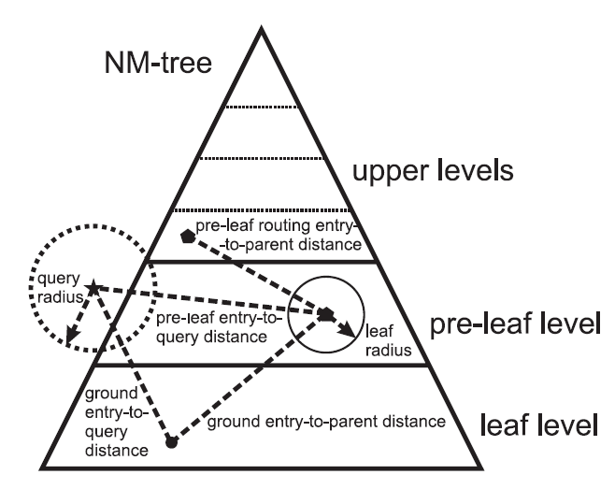
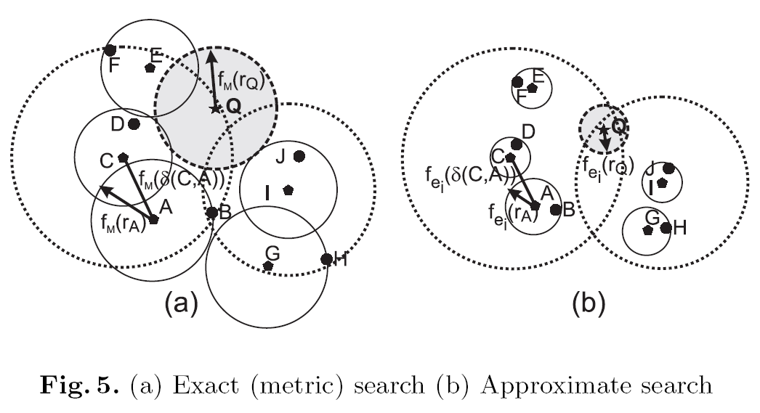
NM-tree
the re-modification takes place just on the pre-leaf, and leaf level,
on upper levels this is not correctly possible, so here the original metric is used

Slide 26
Thank you for your attention!
more on http://siret.ms.mff.cuni.cz

